Slide 1
“Songs In The Night”
(part 2)

Slide 2
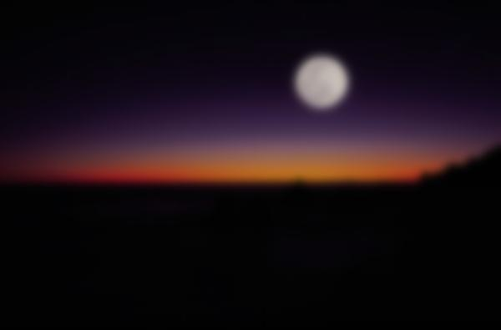
Previously
Elihu’s admonition to Job about songs in the night (Job 35:10)
Is it possible to really have songs (joy) in the night (calamity)?
Psalm 42; 43 – Identifies the common ruts where men get stuck in adversity-no balm for the weary
Dwelling on raw circumstances
Dwelling on the depth of the sorrow
Remembering the way it used to be
Wanting vindication
Hints that the solution is “Hope In God” (42:5)

Slide 3
Psalm 42
Hope in God!
Hoping, trusting and waiting on the power and promises of God is what gives us a song in the night
“…The patient in spirit is better than the proud in spirit” (Eccl. 7:8)
“The LORD will command His lovingkindness in the daytime, And in the night His song shall be with me—A prayer to the God of my life.” (42:8)

Slide 4
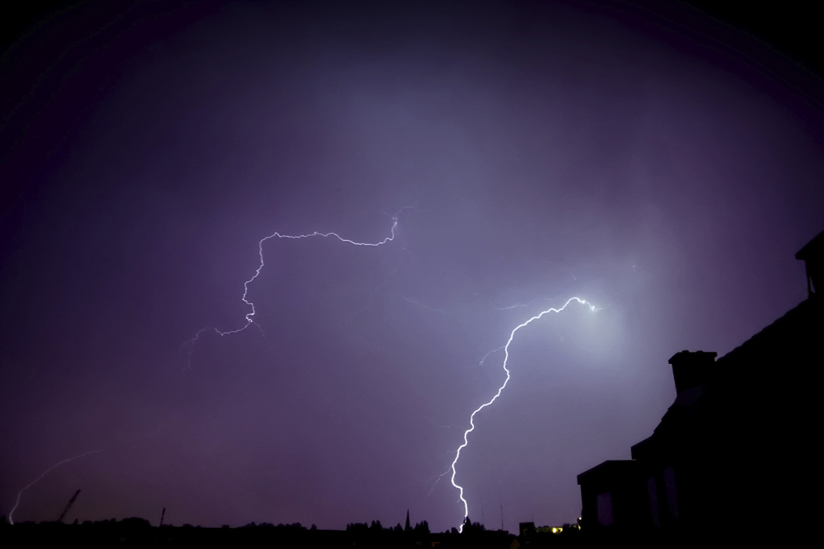
So How Do We Break It Down and Apply This Truth?
What do we need to understand and apply to get songs in the night?
G
O
D

Slide 5
Example of Paul
Where the Psalmist kept rising and falling (Ps. 42:5, 6, 11; 43:5), Paul over abounds in joy
Both were suffering, both were persecuted, both had enemies, both were where they didn’t desire to be…
Yet Paul is lifted up in joy? Paul’s “song in the night” carries the chords of joy…
The joyful remembrance (Phil. 1:3-5, 7)
The joy that Christ is preached (Phil. 1:18)
Anticipation for a joyful reunion (Phil. 1:25, 26)
The joy of brethren being likeminded (Phil. 2:2)
Anticipation of the grand reunion (Phil. 2:16)
The joy of being poured out (sacrificed) for faith (Phil. 2:17, 18), Etc.

Slide 6
Example of Paul
HOW IS PAUL able TO RESPOND WITH JOY?
Fundamentally his joy stems from hope anchored in something unmovable (1 Tim. 1:1)
Who is Jesus Christ our hope (1 Cor. 10:1-4)?
Luke 6:48
His thoughts transcended beyond himself and his painful circumstances (note previous chart’s incomplete list)
He pressed forward and was able to move away from the past (Phil. 3:12-16)
Notes:
In order to be forward reaching, he had to be forgetting what was behind

Slide 7
Hope In God
“HOPE” DEFINED!
“A confident expectation in things beyond this world” (Thompson Chain Reference Bible, #1691, ©1997)
“A confident expectation of eternal life” (ibid., #1692)
Hope is what moves us to the future!

Slide 8
Hope In God
FAITH
Three Mind-Affecting Works In Jesus Christ
PAST – declared righteous
PRESENT – peace and access to grace
FUTURE – hope whereby we boast on the glory of God
Boast (joy, glory) in the glory of God
That which is to come (Rom. 8:18, 23)
“Having been declared righteous, then, by faith, we have peace toward God through our Lord Jesus Christ, through whom also we have the access by the faith into this grace in which we have stood, and we boast on the hope of the glory of God” (Rom. 5:1, 2, YLT)
Notes:
Through Christ Jesus the soul is not “cast down” but lifted up in “joy”
Jesus provides us everything we need for we have been made justified and we continue through the gospel to have access to the favor of God. But it doesn’t end there. Man is forward looking. When he is only present or past looking he may become stuck. He has to work toward something. The glory of God provides man that need. He provides us hope for something still more—to be able to partake and receive His glory in the future. So we desire the glory of God! We expect glory of God! We hope for it and the deeper that hope is, the better the medicine against despair and depression. The more we see it through faith, the bigger and the more beautiful the bridge from here to eternity is. This is one of the grave dangers of worldliness in that it clouds and confuses the hope of the future and therefore makes the present dim and bleak, where faithfulness falters. Brethren, Romans 8:18, 23—we are not yet what we are going to become!

Slide 9
Hope = Desire + Expectation
Romans 8:24, 25, “For we were saved in this hope, but hope that is seen is not hope; for why does one still hope for what he sees? But if we hope for what we do not see, we eagerly wait for it with perseverance.”
One does not hope for what he sees
One hopes for what he does not see
Eagerly wait with perseverance (desires and expects)

Slide 10
Hope = Desire + Expectation
Modeled in Abraham:
“who, contrary to hope, in hope believed, so that he became the father of many nations, according to what was spoken, ‘So shall your descendants be’” (Rom. 4:18)
Contrary to hope- naturally one would not expect to have a child in Abraham’s situation
In hope believed- God’s word at times contradicts human reason…so, Abraham by faith desired and expected a child
Not “wishful thinking,” but an exciting anticipation of something based on a settled understanding and fact

Slide 11
1st Stage of Hope: Is Built From Looking Away From Self and To Jesus and His Gospel
Faith
Hope
Joy
Word of God
Desire
Expectation
Glory of God
“through whom also we have access by faith into this grace in which we stand, and rejoice in hope of the glory of God” (Rom. 5:2)
Notes:
By faith we expect and desire the glory of God, as Abraham did a son. That hope is what generates joy.

Slide 12
How Does This Have An Effect In Times of Distress and Tribulation?
Actually, tribulation is to bring a positive contribution to hope!
Tribulation enlarges hope!

Slide 13
2nd Stage of Hope: Builds From What Is Inside, Looking Into The Transformation Within
tribulation
perseverance
character
hope
Romans 5:3, 4:
3 And not only that, but we also glory in tribulations, knowing that tribulation produces perseverance;
4 and perseverance, character; and character, hope.
constant
proven
Hope #2 has the ingredients within: perseverance (steadfastness) and character (tested/proven character)
Notes:
As we glory in the glory of God, we also gladly glory in tribulation (oppression, affliction, tribulation, distress, straits)!
Perseverance = constancy as opposed to being flighty. It’s weighty. The root word from the Greek from which this word comes, conveys the quality of remaining, not receding or fleeing (cf. Eph. 4:14; Jas. 1:6). The tree which is battered by the storm need not become uprooted, but rather root itself deeper. I like the example of Behemoth for the idea of calm constancy and immovability (Job 40:15-24).
“character” – proven or tested character. The fiery trial of tribulation which is met with constancy and perseverance for Christ results in a “job well done!” Tribulation is something God uses to refine our character! Hence a refining process has occurred and we are made better fit for eternity. Many think that “getting saved” will fix my problems here. That initially obeying the gospel will result in no more change and that God will now bless me with health and wealth because I am a good person. But that is wrong. God uses tribulation on the saved to further refine their character? So how many want to be saved? But how many want to suffer?
Tribulation and patient endurance yields to a larger and more mature and vibrant hope! This results in the longing of heaven all the more!

Slide 14
2nd Stage of Hope: Builds From What Is Inside, Looking Into The Transformation Within
tribulation
perseverance
character
hope
Romans 5:3, 4:
3 And not only that, but we also glory in tribulations, knowing that tribulation produces perseverance;
4 and perseverance, character; and character, hope.
Tribulation tests the inner resolve and makeup of the Christian; if his hope in Christ sustains him, then he has realized an unwavering quality in his faith and salvation!

Slide 15
2nd Stage of Hope: Builds From What Is Inside, Looking Into The Transformation Within
tribulation
perseverance
character
hope
Romans 5:3, 4:
3 And not only that, but we also glory in tribulations, knowing that tribulation produces perseverance;
4 and perseverance, character; and character, hope.
One would have to have “hope¹” in order to even glory in tribulation (1 Cor. 15:19); yet from enduring trials, he gains more hope²—confirmation of genuine transformation!

Slide 16
2nd Stage of Hope: Builds From What Is Inside, Looking Into The Transformation Within
tribulation
perseverance
character
hope
Romans 5:3, 4:
3 And not only that, but we also glory in tribulations, knowing that tribulation produces perseverance;
4 and perseverance, character; and character, hope.
Likewise, when you see the deliverance of God from a form of tribulation, then your hope in God’s future glory for you is made all the stronger!

Slide 17
From Hope To Hope
tribulation
perseverance
character
hope
1
hope
Romans 5:1, 2
2
Romans 5:3, 4
Perseverance, character and hope become songs which are born out of tribulation
Notes:
A perhaps parallel in thought to Ecclesiastics 2:10, “…For my heart rejoiced in all my labor; And this was my reward from all my labor.” The heart rejoiced in the labor and the reward from his labor was a merry heart. In this way he had joy going into his labor and was rewarded with joy from his labor.

Slide 18
From Scars To Hope
tribulation
hope
Scars are a reminder of the past
Scars can carry lessons from the past
Scars evidence healing (Lev. 13:28)
From the scars, hope is made stronger
Notes:
#1 4th grade working in the oil field by fencing in a tank yard with barbed wire fencing. When the wire was strung and cut, it snapped loosed and whipped by my neck/shoulder lacerating the skin. It teaches that you can be wounded from others or perhaps wound others. You may be in an environment where others inflict pain on you. It may be intentional or not. It may be negligence, unplanned or perhaps on purpose. It may be vindictive or for sport but it cuts just the same. What did God see when He looked at the earth (Gen. 6:11). Life may have a barbed pointed quality, but the scar is proof that it can heal and hence hope comes from the scar that you can survive what man inflicts on you.
#2 Using my pocket knife to cut open a package that was tightly bound. I was holding it with one hand and cutting the binding with other and it when it broke the pressure that I applied was too much and it stuck my knife in my wrist. Such teaches me that I can cause my own harm. My own choices may bring about my own demise or hurt. How many times do people bring about their own harm testing drugs, showing off and speeding, carelessness with weapons, running with a dangerous crowd? (Prov. 14:12)
#3 as a teenager during a fourth of July celebration on our ranch in South Dakota. We had a mess of “cherry bombs.” These look like your average smoke bomb, but rather than letting of smoke, they explode. I had one in my hand and lit the fuse to which it immediately exploded in my hand and burned my stomach. I still have a scar there today. It taught me that there is not always a predictableness of things pertaining to this life. It may look like you have a two second fuse but it is really less. Things may look like a harmless smoke bomb, but could really be an explosion waiting to happen. You life may be peace and joy and in a moment’s notice, that can be taken away and replaced with shock, surprise and pain (Eccl. 9:11, 12).

Slide 19
From Scars To Hope
tribulation
hope
“Out of suffering have emerged the strongest souls; the most massive characters are seared with scars” (Kahlil Gibran, 1883-1931)
Perhaps in recognizing Paul’s massive character and hope is seen in appreciating his scars (Gal. 6:17)
Notes:
If one could have viewed the body of this apostle as his remains were being laid to rest. If one could have prepared his body for burial, what would he have seen on the lifeless body of this spiritual giant (2 Cor. 11:23-25)
But his scars were not only external. He had “unseen” scars. Some verses that show that are (2 Tim. 1:15; 2 Tim. 4:10; 4:14-17; 1 Cor. 2:3). Yet in all of this, he was not crushed.

Slide 20
2 Corinthians 4:8-14
8 We are hard pressed on every side, yet not crushed; we are perplexed, but not in despair;
9 persecuted, but not forsaken; struck down, but not destroyed—
10 always carrying about in the body the dying of the Lord Jesus, that the life of Jesus also may be manifested in our body.
11 For we who live are always delivered to death for Jesus’ sake, that the life of Jesus also may be manifested in our mortal flesh.

Slide 21
2 Corinthians 4:8-14
12 So then death is working in us, but life in you.
13 And since we have the same spirit of faith, according to what is written, "I believed and therefore I spoke," we also believe and therefore speak,
14 knowing that He who raised up the Lord Jesus will also raise us up with Jesus, and will present us with you.
THE REASON!

Slide 22
May This Be Our Song In The Night
“My hope is built on nothing less than Jesus’ blood and righteousness. I dare not trust the sweetest frame, but wholly lean on Jesus’ name.”
“When darkness seems to hide His face, I rest on His unchanging grace. In every high and stormy gale, My anchor holds with in the veil.”
“His oath, His covenant, His blood, support me in the whelming flood. When all around my soul gives way, He then is all my hope and stay.”
“When He shall come with trumpet sound, O may I then in Him be found! Dressed in His righteousness alone, faultless to stand before the throne!”
“On Christ the solid Rock I stand, all other ground is sinking sand. All other ground is sinking sand.” (The Solid Rock, Edward Mote, 1834)

